Slide 1
Natural Language Processing
Dr Ossama Alshabrawy
ossama.alshabrawy@northumbria.ac.uk

Slide 2
Agenda
Introduction to Natural Language Processing
Exploring Natural Language Solutions in Azure
Understand how NLP & Text analytics work
Word2Vec Model

Slide 3







What is Natural Language Processing?
The area of AI that that deals with making sense of written and spoken language.
 | Text analysis and entity recognition
 | Sentiment analysis
 | Speech recognition and synthesis
 | Machine translation
 | Semantic language modeling

Slide 4
Text analysis and entity recognition
Analyse a text document to determine its salient points or to identify entities
dates, places, people,….
For example, a company might use AI to analyze industry magazine articles to try to find articles that mention their products or executives or to determine the main subject of each article.

Slide 5
Sentiment analysis
A common form of text analysis that calculates a score indicating how positive (or negative) a text extract is.
Example: a retailer might analyze reviews from customers to determine which ones are positive and which are negative.
AI systems that can recognize spoken language as input and synthesize spoken output.
Example: in-car hands free communication system to read incoming messages
Speech Recognition and synthesis

Slide 6
Analyzing Text
I had a wonderful vacation in France.
Predominant Language: English
Sentiment: 88% (positive)
Key Phrases: "wonderful vacation"
Entities: France

Slide 7

Speech Recognition and Synthesis
Use the speech-to-text
capabilities of the Speech service to transcribe audible speech to text
Use the text-to-speech
capabilities of the Speech service to generate audible speech from text

Slide 8
Machine Translation
AI can be used to automate translation of written and spoken language.
Example: inbox add-in to automatically translate incoming or outgoing emails.
Language can be complex and nuanced, so that multiple phrases might be used to mean the same thing.
Example: you may ask "Where can I get gas near here?", "What's the location of the closest gas station?", or "Give me directions to a gas station."
Semantic language modelling

Slide 9

Translation
Translator service
Bonjour
Hello
Hola
Speech service
Hello
你好

Slide 10
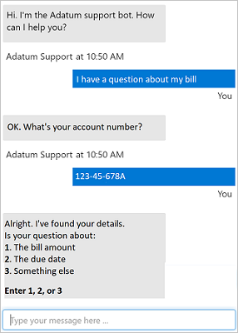
What is Conversational AI?
A solution that enables a dialog between an AI agent and a human
Generically, conversational AI agents are known as bots
Bots can engage over multiple channels:
Web chat interfaces
Email
Social media platforms
Voice

Slide 11

Conversational Language Understanding
Switch the light on.
Entity
Intent
Utterance

Slide 12


Question Answering
Define a knowledge base of question and answer pairs:
By entering questions and answers
From an existing FAQ document
By using built-in chit-chat
Use the knowledge base from client apps, including bots
?
!

Slide 13
Now, let’s explore Natural Language Solutions in Azure?

Slide 14
Natural Language Processing and Conversational AI in Azure
Language | Language detection Key phrase extraction Entity detection Sentiment analysis Question answering Conversational language understanding
Speech | Text to speech Speech to text Speech translation
Translator | Text translation
Azure Bot Service | Platform for conversational AI

Slide 15







Azure Bot Service
Cloud-based platform for developing and managing bots
Integration with Language and other services
Connectivity through multiple channels

Slide 16

Review
What are some capabilities included in the Language service?
Translation and Azure bot deployment
Speech recognition
Text analysis, custom question answering, conversational language understanding
You want to use the Language service to determine the key talking points in a text document. Which feature of the service should you use?
Sentiment analysis
Key phrase extraction
Entity detection
You want to create a knowledge base for bots. What service would you use?
Conversational Language Understanding with the Language service
Question Answering with the Language service
Azure Bot Service

Slide 17
Understand Text Analytics - Tokenisation
The first step in analysing a corpus is to break it down into tokens.
For simplicity, you can think of each distinct word in the training text as a token
In reality, tokens can be generated for partial words, or combinations of words and punctuation.
Example: "we choose to go to the moon” -> tokens:
1: we , 2: choose, 3: to, 4: go, 5: the, 6: moon
3 is used twice
"we choose to go to the moon" can be represented by the tokens [1,2,3,4,3,5,6].

Slide 18
Understand Text Analytics - Tokenisation
Tokenisation still needs preprocessing -> depends on the NLP problem
Text normalisation: Before generating tokens, you may choose to normalise the text by removing punctuation and changing all words to lower case.
Issue: sometimes semantic meaning may be lost. Example: "Mr Banks has worked in many banks.”
Stop words removal: should be excluded from the analysis
For example, "the", "a", or "it”

Slide 19
Understand Text Analytics - Tokenisation
n-grams: multi-term phrases such as "I have" or "he walked".
single word phrase is a unigram, a two-word phrase is a bi-gram, a three-word phrase is a tri-gram, and so on
Stemming: words with the same root are interpreted as being the same token.
Example: "power", "powered", and "powerful"

Slide 20
Understand Text Analytics – Frequency Analysis
After tokenisation, perform some analysis to count the number of occurrences of each token.
The most common words (other than stop words: "a", "the", ….) can often provide a clue as to the main subject of a text corpus.
"go to the moon” if it previously included: "new", "go", "space", and "moon”
If we tokenise bi-grams, in this case: "the moon”
So, text is concerned with space travel and going to the moon.

Slide 21
Understand Text Analytics – Frequency Analysis
How to determine which tokens are most relevant in each document across multiple documents within the same corpus?
Term frequency - inverse document frequency (TF-IDF)
TF-IDF: how often a word or term appears in one document compared to its more general frequency across the entire collection of documents.

Slide 22
Understand Text Analytics – Machine Learning for classification
Using classification algorithms: logistic regression, SVM, RF, etc.
to train a model that classifies text as positive (label 1) or negative (label 0) to perform sentiment analysis or opinion mining.
The food and service were both great: 1
A really terrible experience: 0
Mmm! tasty food and a fun vibe: 1
Slow service and substandard food: 0

Slide 23
Machine Learning for classification
The model will encapsulate a relationship between tokens and sentiment
tokens for words like "great", "tasty", or "fun" -> sentiment of 1 (positive)
tokens for "terrible", "slow", and "substandard” -> negative sentiment

Slide 24
Semantic language models
With the advance of NLP -> powerful language models
The ability to train models that encapsulate the semantic relationship between tokens.
How? by the encoding of language tokens as vectors (multi-valued arrays of numbers) known as embeddings.
The closer tokens are to one another along a particular dimension, the more semantically related they are.
related words are grouped closer together.

Slide 25
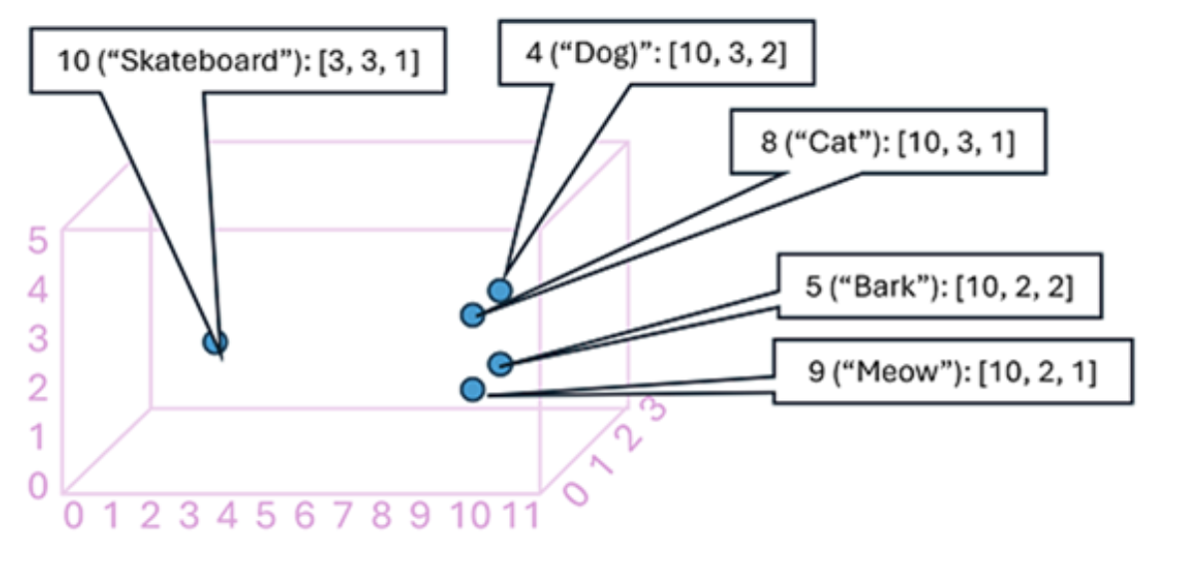
Semantic language models

Slide 26
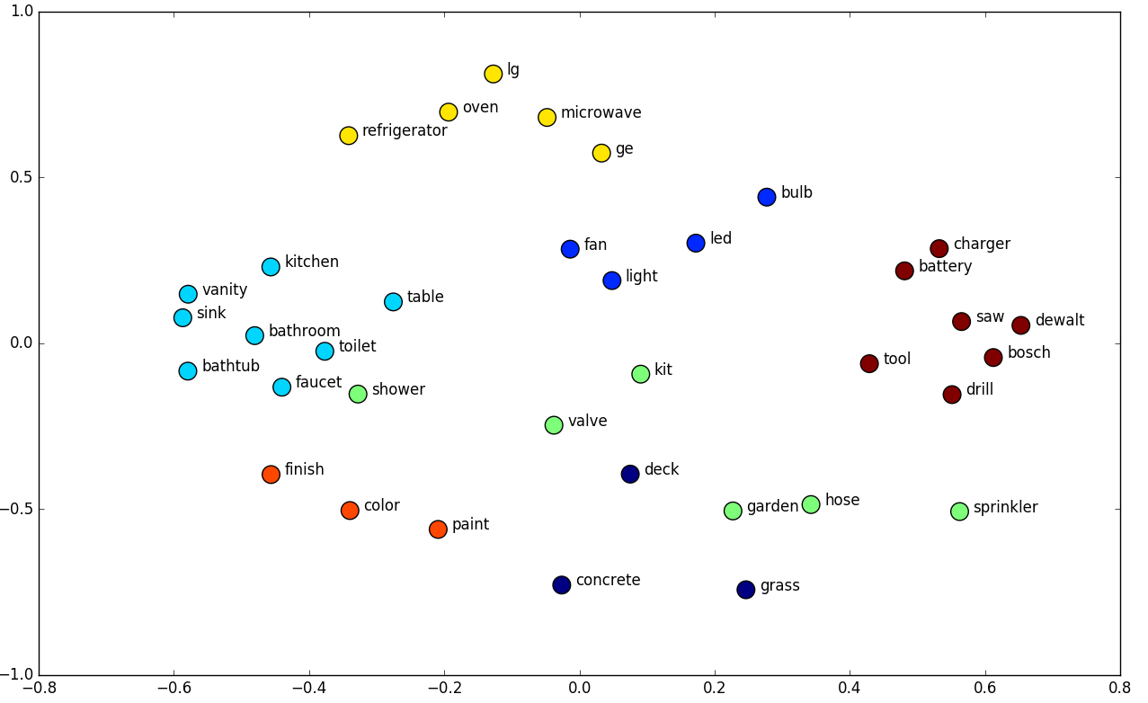
Semantic language models

Slide 27
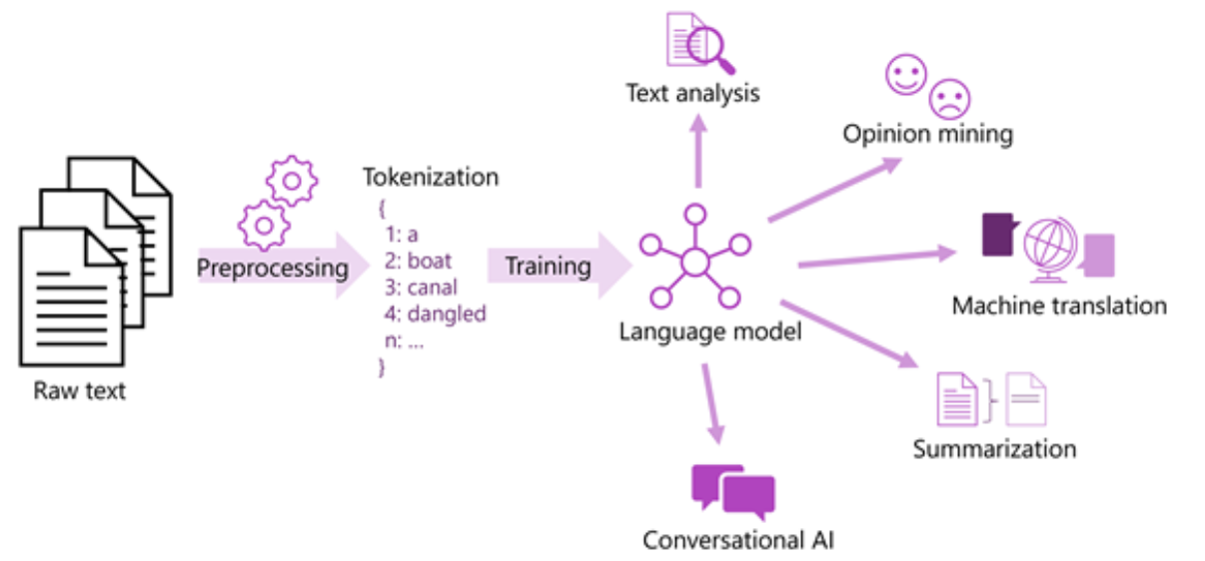
Semantic language models

Slide 28
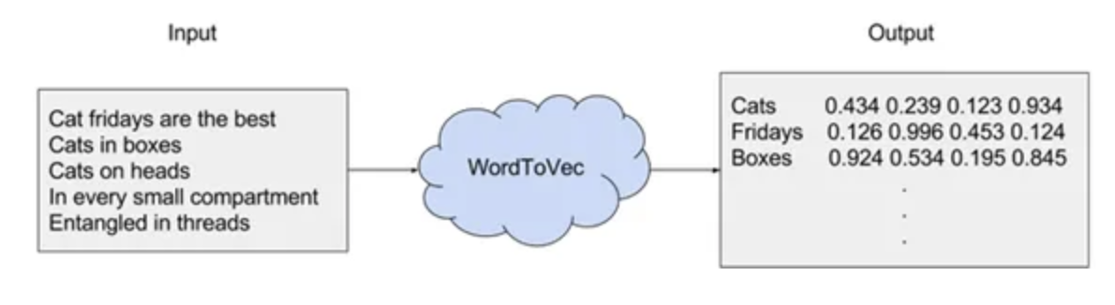
Word2Vec
One of the emerging and prominent word embedding techniques. [by Mikolov et al., 2013]
Word2Vec is an algorithm that accepts text corpus as an input and outputs a vector representation for each word
Two methods for this algorithm: CBOW, Skip-Gram

Slide 29
Word2Vec
The corpus is a set of sentences
The model loops over the words of each sentence tries to either predict the current word w or to predict its neighbours (i.e., its context)
To limit the number of words in each context -> a parameter called “window size”
Example window size of 2
Current Word, 2 previous and 2 next

Slide 30
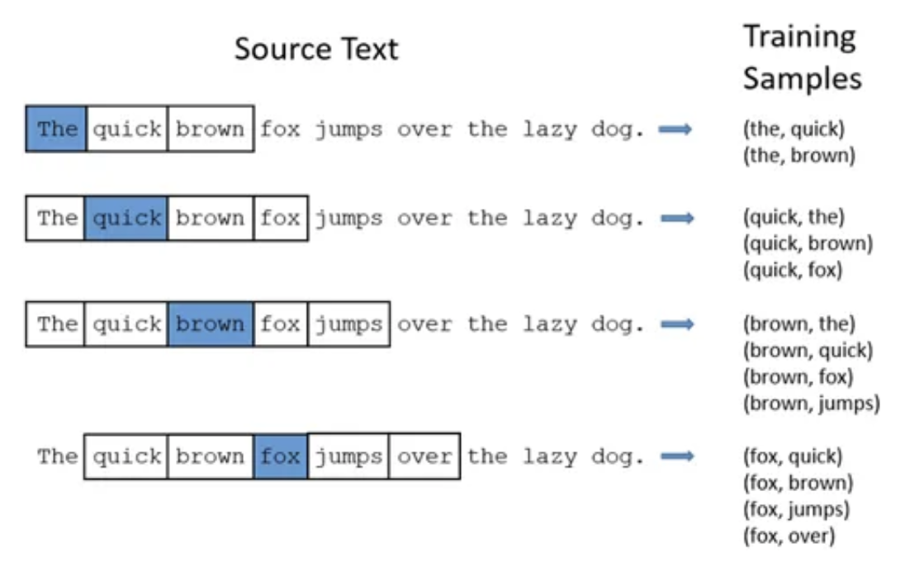
Word2Vec

Slide 31
Word2Vec
Skip-Gram: The model loops over the words of each sentence tries to use the current word w to predict its neighbours (i.e., its context)
CBOW (Continuous Bag Of Words): The model uses each of these contexts to predict the current word w.
Skip Grams is mostly used as it produce more accurate results on large datasets

Slide 32
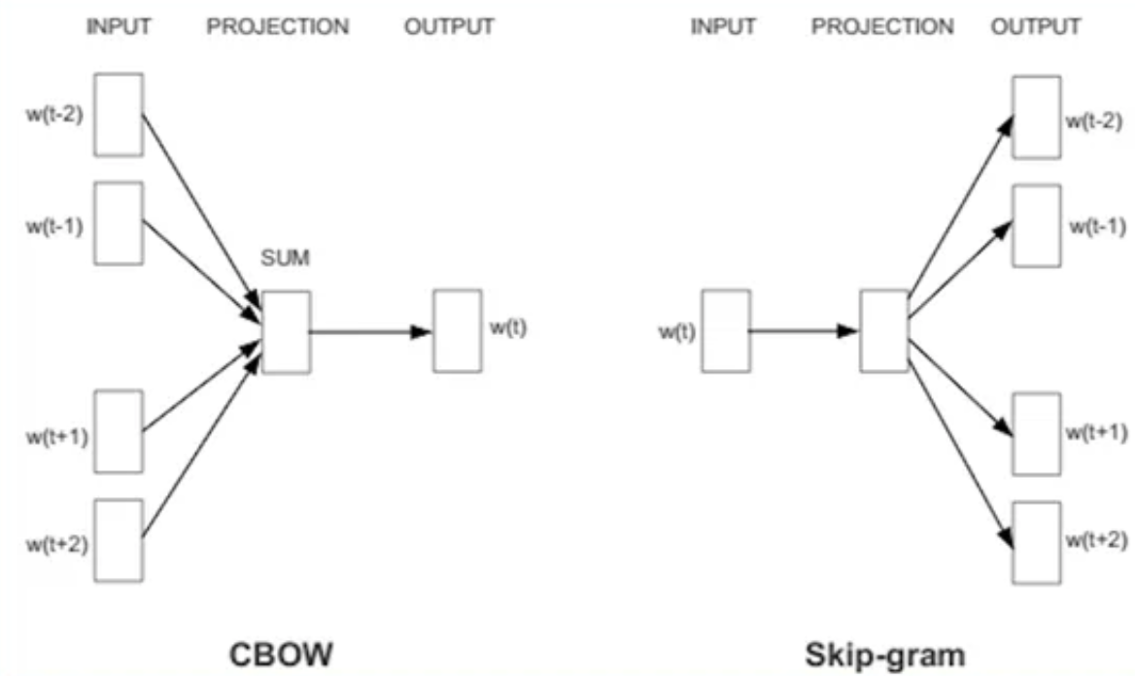
Word2Vec

Slide 33
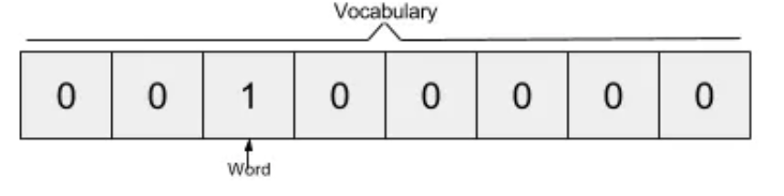
Word2Vec
Step 1: Create vocabulary of all unique words in corpus and then to encode the word as a vector of the same dimensions of the vocabulary.
This encoding technique is called one-hot encoding.
“the”, “quick”, “brown”, “fox”, “jumps”, “over”, “the” “lazy”, “dog” -> the word “brown” is represented by
Words in the vocabulary are ordered alphabetically; each word can be referenced by its index.

Slide 34
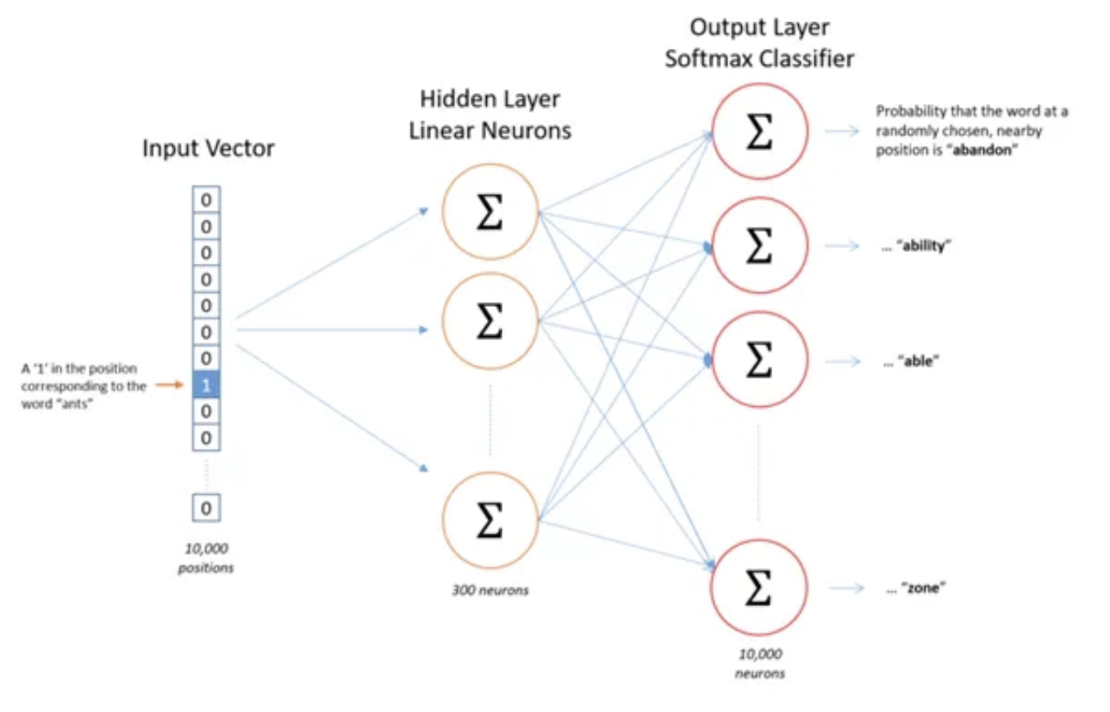
Word2Vec
Step 2: use the vectors as inputs to a neural network. The input vectors are one-hot will be multiplied by an input vector by the weight matrix W1

Slide 35
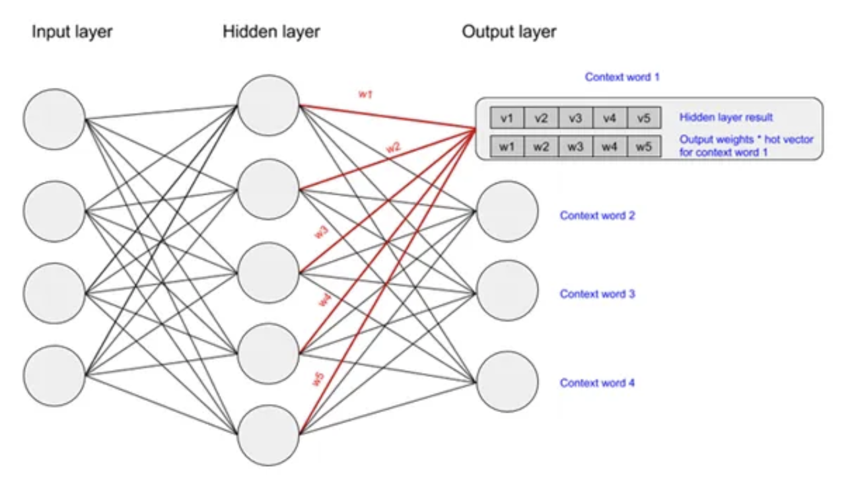
Word2Vec

